Slide 1
Chapter 2.
Spoken Language Structure
2.1 SOUND AND HUMAN SPEECH SYSTEMS
2.2 PHONETICS AND PHONOLOGY
2.3 SYLLABLES AND WORDS
2.4 SYNTAX AND SEMANTICS
2.5 HISTORICAL PERSPECTIVE AND
FURTHER READING

Slide 2
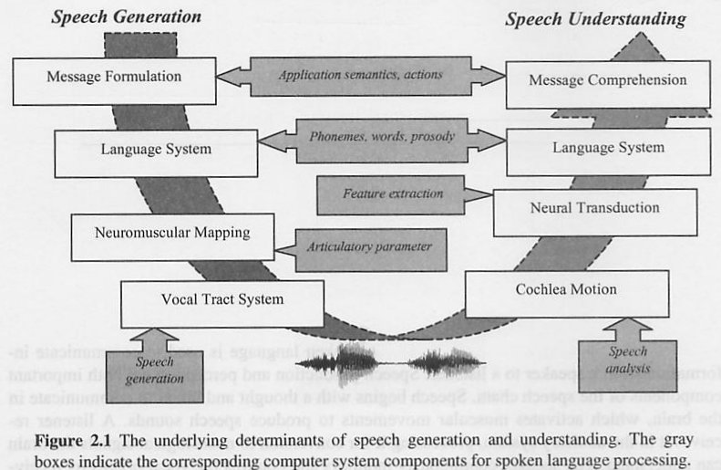
Universal Components of Speech Communication

Slide 3
2.1 Sound and Human Speech Systems
We hope spoken language research will enable us to build a computer system that is as good as or better than our own speech production and understanding system.

Slide 4
Sound propagation and Intensity
Sound is longitudinal(縱波) pressure wave formed of compressions and rarefactions of air molecules, in a direction parallel to that of the application of energy.

Slide 5
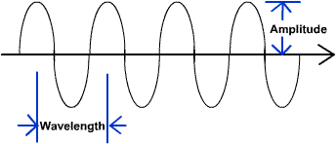
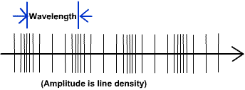
Water wave & Sound wave
The speed of a sound :
331.5 + 0.6T m/s,
where T is the Celsius Temperature.

Slide 6
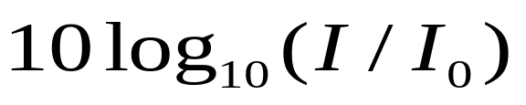
Sound Intensity & SPL
It is convenient to measure sound amplitude on a logarithmic scale in decibels(dB), a decibel scale is a means for comparing the intensity of two sounds.
,where I and I₀ are the two intensity levels, with intensity being proportional to the square of the sound pressure P.

Slide 7
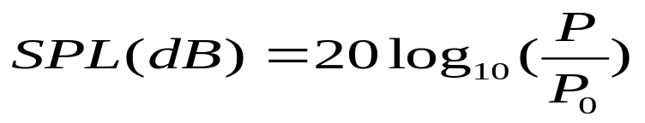
Sound Pressure Level (SPL)
Sound pressure level(SPL) is a measure of absolute sound pressure P in dB
, where 0 dB corresponds to the threshold of hearing (TOH).(20 µPa=N/m² roughly the sound of a mosquito flying 3 m away).
The faintest audible sound is arbitrarily assigned a value of 0 dB, and the loudest sounds that the human ear can tolerate are about 120 dB

Slide 8
Intensity & decibel levels of various sounds
Sound | dB Level | TOH
Threshold of hearing | 0 | 10⁰
Light whisper | 10 | 10¹
Quiet living room | 20 | 10²
Quiet conversation | 40 | 10⁴
Average office | 50 | 10⁵
Normal conversation | 60 | 10⁶
Busy city street | 70 | 10⁷
Acoustic guitar –1ft.away | 80 | 10⁸
Heavy truck traffic | 90 | 10⁹
Subway from platform | 100 | 10¹⁰
Power tools | 110 | 10¹¹
Pain threshold of ear | 120 | 10¹²

Slide 9
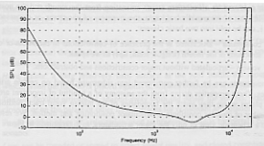
TOH as a function of Frequency
The absolute threshold of hearing is a function of frequency that can be approximated by
*SPL level is dB of the absolute threshold of hearing as a function of frequency

Slide 10
Speech Production
Human speech production apparatus
  Lungs : source of air during speech
  Vocal cords(larynx) : when the vocal folds are held close together and oscillate against one another during a speech sound, the sound is said to be voiced.
  When the folds are too slack or tense to vibrate periodically, the sound is said to be unvoiced.
  The place where the vocal folds come together is called the glottis.

Slide 11
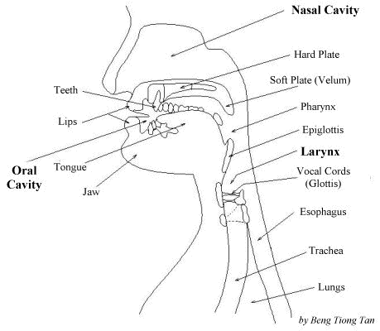
Human speech production apparatus

Slide 12
  Velum(軟齶): operates as a valve, opening to allow passage of air through the nasal cavity.
  Hard palate(上顎): a long relatively hard surface at the roof inside the mouth, which, when the tongue is placed against it, enables consonant articulation.
  Tongue : flexible articulator, shaped away from the palate for vowels, placed close to or on the palate or other hard surfaces for consonant articulation.
  Teeth : another place of articulation used to brace the tongue for certain consonants.
  Lips : can be rounded or spread to affect vowel quality , and closed completely to stop the oral air flow in certain consonants.

Slide 13
The vocal tract which forms the resonance tube in the speech production system mainly consists of pharynx, nasal cavity and oral cavity.
The shape of the vocal tract is varied by the soft plate (velum), tongues, lips and jaw which are collectively called as the articulators.
The process of shaping the vocal tract to produce different speech is called articulation.

Slide 14
The air flow from the lungs travels up the trachea, a tube consisting of rings of cartilage, and through the larynx toward the vocal tract
The larynx acts as a gate between lungs and mouth. It consists of epiglottis(喉頭蓋), vocal cords and false vocal cords. They are closed during swallowing - to ensure that food is deflected from the wind pipe and lungs - and wide opening during normal breathing.

Slide 15
Voicing mechanism
When the vocal folds vibrate during phoneme articulation, the phoneme is considered voiced; otherwise it is unvoiced.
The distinct vowel timbres are created by using the tongue and lips to shape the main oral resonance cavity in different ways.
The vocal folds vibrate at slower or faster rates; the rate of cycling(opening and closing) of the vocal folds in the larynx during phonation of voiced sounds is called the fundamental frequency.The fundamental frequency also contributes more than any other single factor to the perception of pitch in speech.

Slide 16
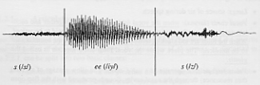
Waveform of “sees”
*voiced sounds typically have more energy than unvoiced.

Slide 17

Vocal fold cycling at the larynx
(a) closed with sub-glottal pressure buildup
(b) trans-glottal pressure differential causing folds to blow apart
(c) pressure equalization and tissue elasticity forcing temporary reclosure of vocal folds, ready to begin next cycle

Slide 18
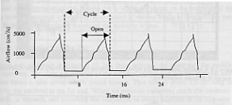
Waveform showing air flow during laryngeal cycle

Slide 19
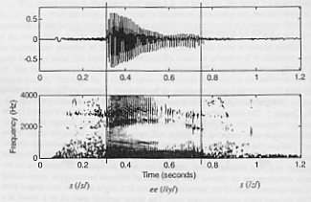
Spectrograms & Formants
Another view of waveform, called spectrogram.
Example:
  spectrogram representation of the speech waveform sees.
*Dark horizontal bands show the formants, which are harmonics of the fundamental at natural resonance of the vocal tract cavity position for the vowel /iy/ in sees.

Slide 20
Speech Perception (Demo)
Two major components in auditory perception system
  Peripheral auditory organs (ears)
  Auditory nervous system (brain)
Acoustic
pressure signal
Mechanical
Vibration pattern
Auditory nerve
(series of pulses)
Basilar membrane
Perceptual Information

Slide 21
Physiology of the Ear
Three sections in human ear
  Outer ear
    Consists of the external visible part and external auditory canal that forms a tube along which sound travels.
  Middle ear
    An air-filled cavity, air travels to the middle ear cavity along the tube that connects the cavity with the nose and throat.
  Inner ear
    Inner ear for sound perception is the cochlea, which communicates directly with the auditory nerve, conducting a representation of sound to the brain.

Slide 22
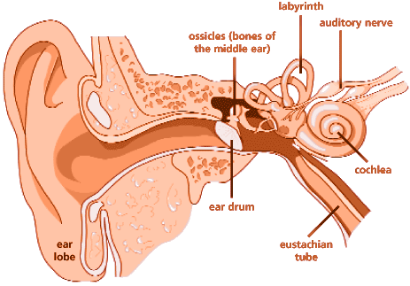
Physiology of the Ear (cont.)

Slide 23
Physical vs. Perceptual Attribute
Physical Quantity | Perceptual Quality
Intensity | Loudness
Fundamental frequency | Pitch
Spectral shape | Timbre(音色)
Onset/offset time | Timing
Phase difference in binaural hearing | Location
*Relation between perceptual & physical attributes of sound

Slide 24
Physical vs. Perceptual Attribute
(cont.)
The sensitivity of the ear varies with the frequency and the quality of the sound.
One fundamental divergence between physical and perceptual qualities is the phenomenon of non-uniform equal loudness perception of tones of varying frequencies.
In general, tones of differing pitch have different inherent perceived loudness.
Pitch is indeed most closely related to the fundamental frequency.
  The higher the fundamental frequency , the higher the pitch we received.

Slide 25
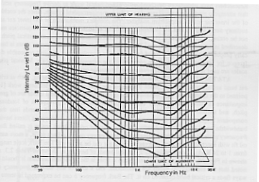
Equal-loudness curves
*Indicate the response of the human hearing mechanism is a function of frequency and loudness level

Slide 26
Frequency analysis
AT&T Bell Labs has contributed many influential discoveries in hearing, such as critical band and articulation index.
Fletcher’s work pointed to the existence of critical bands in the cochlear response.
Critical bands are of great importance in understanding many auditory phenomena such as perception of loudness, pitch, and timbre.
The auditory system performs frequency analysis of sounds into their component frequencies.

Slide 27
Frequency analysis(cont.)
The cochlea acts as if it were made up of overlapping filters having bandwidths equal to the critical bandwidth.
Bark scale is one class of critical band scales, which ranges from 1 to 24 Barks, corresponding to 24 critical bands of hearing. The Bark frequency b can be expressed in terms of the linear frequency (in Hz) by

Slide 28
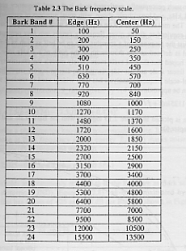
Bark frequency scale

Slide 29
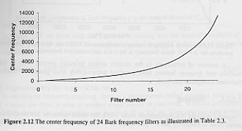
Center frequency of 24 Bark frequency filters

Slide 30

Mel Frequency scale
Mel-scale is linear below 1 kHz, and logarithmic above.
Mel-scale frequency analysis has been widely used in modern speech recognition system. It can be approximated by:

Slide 31
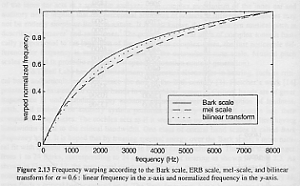
Mel scale vs. Bark scale vs. bilinear transform

Slide 32
Masking
Frequency masking is a phenomenon under which one sound cannot be perceived if another sound close in frequency has a high enough level.

Slide 33
Tone-masking noise
Noise with energy E_{N} (dB) at Bark frequency g masks a tone at Bark frequency b if the tone’s energy is below the threshold.
where the spread-of-masking function S_{m}(b) is

Slide 34

Contribution of Bark frequency g to the masked threshold S_{m}(b)

Slide 35
Noise-masking tone
A tone at Bark frequency g with energy E_{T}(dB) masks noise at Bark frequency b if the noise energy is below the threshold.

Slide 36

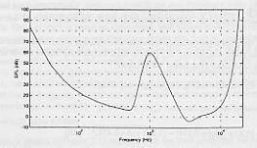
Combined threshold of hearing & masked threshold of a tone at 1 kHz with a 69 dB SPL
The combined masked threshold is the sum of the two in the linear domain

Slide 37
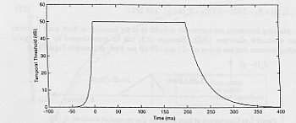
Temporal masking
Definition
  A sound too close in time to another sound cannot be perceived.
* Temporal masking level of a masker with a uniform level starting at 0 ms and lasting 200 ms

Slide 38
2.2 Phonetics & Phonology(demo)
Phonetics(語音學)
  Speech sounds and their production, classification and transcription
Phonology音系學;語音體系
  Distribution and patterning of speech sounds in a language and of the tacit(法定的)rules governing pronunciation.

Slide 39
Phonemes [‘fonim]
Definition: Phoneme is used to denote any of the minimal units of speech sound in a language that can serve to distinguish one word from another.
  Phone : denote a phoneme’s acoustic realization
  Example
    /t/ have two very different acoustic realization for “sat” & “meter”
      Sat : voiceless alveolar (齒槽音,齒齦音) plosive(破裂音)
      Meter : alveolar(齒槽音) flap

Slide 40
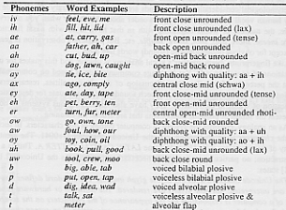
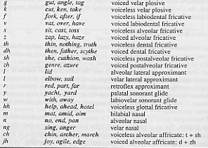
English Phonemes used for typical spoken language systems

Slide 41
Vowels (母音,韻母)
(Fig2-17,2-18 in textbook)
Variation of tongue placement give each vowel its distinct character by changing the resonance, just as different sizes and shapes of bottles give rise to different acoustic effects when struck
The major resonances of the oral and pharyngeal cavities for vowels are called F1 & F2 , which are determined by tongue placement and oral tract shape in vowels and they determine the characteristic timbre or quality of the vowel.
F1 & F2 values for vowels are sometimes called formant targets which are ideal location for perception.

Slide 42
Vowels (cont.)
Example
  “see” , the tongue extrusion is far forward in the mouth, creating an exceptionally long rear cavity, and correspondingly low F1; the forward part of the oral cavity , at the same time, is extremely short, contributing to higher F2.

Slide 43
Phoneme labels & typical formant
(共振峰)values for vowels of English
Vowel labels | Mean F1(Hz) | Mean F2(Hz)
iy(feel) | 300 | 2300
ih(fill) | 360 | 2100
ae(gas) | 750 | 1750
aa(father) | 680 | 1100
ah(cut) | 720 | 1240
ao(dog) | 600 | 900
ax(comply) | 720 | 1240
eh(pet) | 570 | 1970
er(turn) | 580 | 1380
ow(tone) | 600 | 900
uh(good) | 380 | 950
uw(tool) | 300 | 940

Slide 44
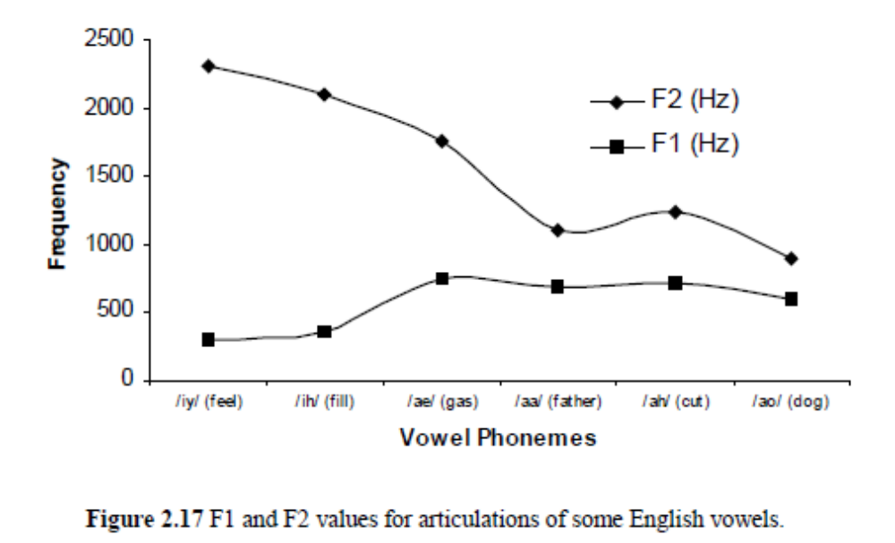

Slide 45
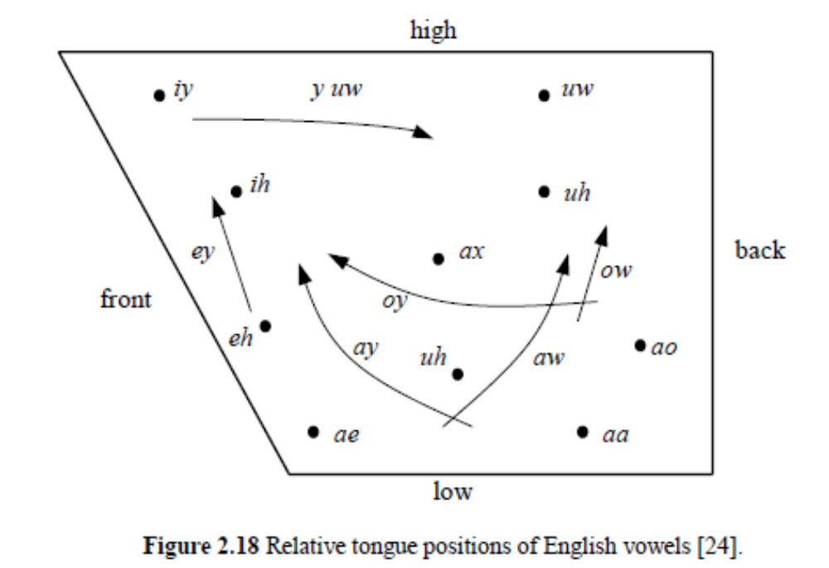

Slide 46
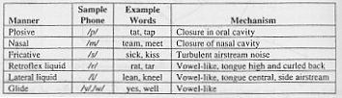
Consonants (Fig. 2-21 in textbook)
Consonants, as opposed to vowels, are characterized by significant constriction(緊壓) or obstruction in the pharyngeal and/or oral cavities.
Some consonants are voiced; others are not.
Retroflex liquid(捲舌音)
Lateral(旁流音,側音) glide(滑音)
*Consonant manner of articulation

Slide 47
Consonants (cont.)
English phones have voicing without complete obstruction or narrowing of the vocal tract are called semivowels.
  Ex. /l, r/, the liquid group; /y, w/, the glide group
Liquids, glides, and vowels are all sonorant, meaning they have continuous voicing
Non-sonorant consonants: require completer or close to complete obstruction include
  Maintain some voicing before or during the obstruction , until the pressure differential across the glottis starts to disappear, due to the closure. Ex. / b, d, g, zh, v/
  A set of counterparts that differ only in their characteristic lack of voicing: /p, t, k, s, sh, f/

Slide 48
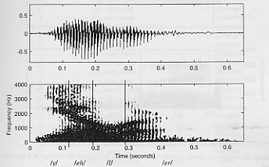
Spectrogram for the word yeller, showing semivowels /y/, /l/, /er/

Slide 49
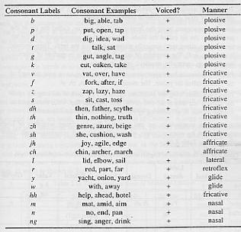
Manner of articulation of English consonants

Slide 50
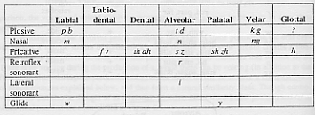
Consonants of English arranged by place(columns) & manner(rows)
唇齒音 唇音 齒音 齒槽音 顎音 軟顎音 聲門音

Slide 51
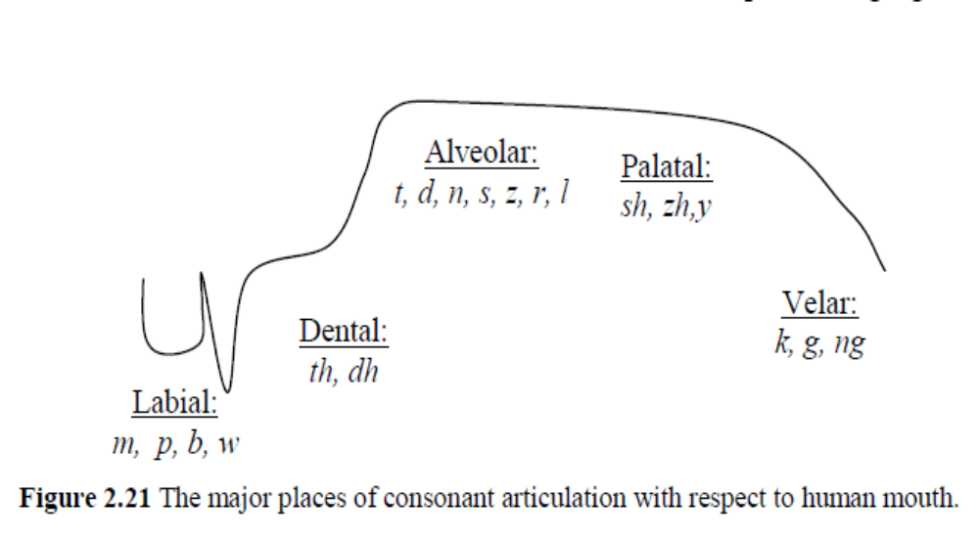

Slide 52
Phonetic typology(類型學)
It is expected all languages would utilize vocal mechanisms, in an internally consistent but essentially arbitrary fashion, to represent their lexicons.
Vocal effect is part of the systematic linguistic phonetics of one language is present in others in a less codified, but still perceptible, form.
  Japanese vowels have a characteristic distinction of length that can be hard for non-native to perceive and to use when learning the language.
  Example : kado(corner) vs. kaado(card) are spectrally identical, differing only in that kado is much shorter in all contexts.

Slide 53

Phonetic typology (cont.)
Other interesting sounds that the English language makes no linguistic use of include the trilled r sound and the implosive.
Many of the huge language families of Asia and Africa are tonal, which English lacks, including all varieties of Chinese.

Slide 54
The Allophone (同位音): sound and context
The process by which neighboring sounds influence one another is called coarticulation. When the variations resulting from coarticulatory processes can be consciously perceived, the modified phonemes are called allophones.

Slide 55
The Allophone sound and context (cont.)
Example
  Experiment with sound /p/ by holding a piece of tissue in front of your mouth while saying the word pin in a normal voice and repeat this experiment with spin. Word pin produces a noticeable puff of air, called aspiration. But the word spin loses its aspiration. Because these two types of /p/ are completely determined by phonetic and syllabic context, the difference is considered allophonic.

Slide 56
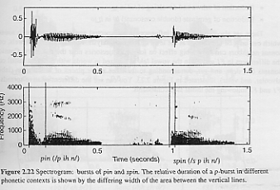
Spectrogram: bursts of pin & spin
p
p

Slide 57
Speech Rate & coarticulation
Individual speakers may vary their rates according to the content and setting of their speech. At the faster rates, formant targets are less likely to be fully achieved.

Slide 58
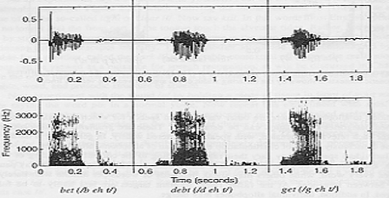
Coarticulation
For vowels, consonant neighbors can have a big effect on formant trajectories near the boundary.
Example: different relative spreads of F1 & F2 in the vowel /eh/ following with different initial consonants (bet, debt, and get).

Slide 59
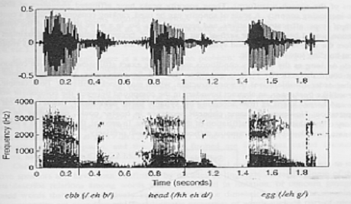
Coarticulation (cont.)
Increasing relative spread of F1 & F2 at the final vowel-consonant transition in each word. (ebb, head, egg)

Slide 60
2.3 Syllable and words
Phonemes are small building blocks.
To contribute to language meaning, phonemes must be organized into longer cohesive spans, and the units so formed must be combined in characteristic patterns such as syllables and words.

Slide 61
2.3.1 Syllables
Between the phones and the word level
Generally centered around vowels in English
Syllable centers can be thought of as peaks in sonority
A scale of sonority(響度) can be used, ranking consonants along a continuum of stops, affricates, fricatives, and approximants.

Slide 62
Syllables are thought to have internal structure, and the terms used are worth knowing
Ex. Strengths
Figure 2.25 the word/syllable strengths (/s t r eh nx th s/) is the longest syllable of English
Syllalbe
Onset(開始)
Rime(韻)
Nucleus
Coda(結尾)
str
eh
nx th s

Slide 63
2.3.2 Words
Words can loosely defined as a lexical item.
Paradigmatic properties of words:
  POS, inflectional and derivational morphology, and compound structure.
Syntagmatic:
  Behavior and distribution when combined for communicative purposes in fully functioning utterances

Slide 64
2.3.2.1 Lexical Part-of-Speech
A primitive form of linguistic theory that posits a restricted inventory of word-type categories
Typical set of POS categories
  Based on grammatical and lexical analysis
  Noun, verb, adjective, adverb, interjection, conjunction, determiner, preposition, and pronoun.
Open-class categories V.S. closed-class categories

Slide 65
Table 2.12 open POS categories
Tag | Description | Function | Example
N | Noun | Names entity | Cat
V | Verb | Names event or condition | Forget
Adj | Adjective | Descriptive | Yellow
Adv | Adverb | Manner of action | Quickly
Interj | Interjection | Reaction | Oh!

Slide 66
Table 2.13 closed POS categories
Tag | Description | Function | Example
Conj | Conjunction | Coordinates phrases | And
Det | Determiner | Indicates definiteness | The
Prep | Preposition | Relations of time, space, direction | From
Pron | Pronoun | Simplified reference | she

Slide 67
The set of POS categories can be extended indefinitely
EX.
Table 2.14 Treebank POS categories – an expanded inventory
You can find the proliferation of sub-categories, such as Verb, base form and Verb, past tense.
These categories incorporate morphological attributes of words into the POS label system discussed in Section 2.3.2.3.
String | Description | Example
CC | Coordinating conjunction | And
CD | Cardinal number | Two
EX | Determiner | The
FW | Existential there | There
IN | Foreign word | Omerta
JJ | Preposition, subord, conjunction | Over, but
JJR | Adjective | Yellow
JJS | Adjective, comparative | better

Slide 68
2.3.2.2 Morphology (形態學)
Morphology is about the subparts of words, i.e., the patterns of word formation including inflection, derivation, and the formation of compounds.
English mainly uses prefixes and suffixes to express inflection and derivational morphology
Inflectional morphology
  deals with variations in word form that reflect the contextual situation of a word in phrase or sentence syntax
  -s, -ed, -ing, -er, -est,..etc.

Slide 69
Derivational morphology
  a given root word may serve as the source for wholly new words, often with POS changes as illustrated in Table 2.15
  re-, pre-, -ial, -ism, -ment,…,etc.
Table 2.15 Examples of stems and their related forms across POS categories
Noun | Verb | Adjective | Adverb
Criticism | Criticize | Critical | Critically
Fool | Fool | Foolish | Foolishly
Industry, industrialization | Industrialize | Industrial, industrious | Industriously
Employ, employee, employer | Employ | Employable | Employably
Certification | Certify | Certifiable | Certifiably

Slide 70
2.3.2.3 Word Classes
Groups according to their actual behavior in real text and speech from statistical point of view
Can be used in language modeling experiments for speech recognition, text analysis for text-to-speech synthesis, etc.
Advantages:
  Has potential to derive more refined classes than traditional POS
  May group words automatically according to the similarity of usage with respect to their word neighbors

Slide 71
Ex. (grouped together based on the semantic meaning)
  {Friday Monday Thursday ……Sunday weekends}
  {Great big vast sudden ……colossal}
  {down backwards ashore sideways……adrift}
Ex.(identify semantic relatedness across traditional POS categories)
  {problems problem solution……solving}
  {write writes writing……pen}
  {question questions asking……qnswering}

Slide 72
2.4 Syntax and Semantics
Syntax is the study of the patterns of formation of sentences and phrases from words and the rules for the formation of grammatical sentences.
Semantics is another branch of linguistics dealing with the study of meaning, including the ways meaning is structured in language and changes in meaning and form over time.

Slide 73
2.4.1 Syntactic Constituents
Constituents represent the way a sentence can be divided into its grammatical subparts as constrained by common grammatical patterns
Syntactic consitituents is the linear order of words in utterances and text.

Slide 74
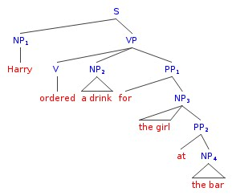

Slide 75
2.4.1.1 Phrase Schemata
Words may be combined to form phrases that have internal structure and unity
Phrase schemata is a simple, uniform template that is independent of POS category
To generalize this, we consider a word of arbitrary category, say category X (which could be a noun N or a verb V). The generalized rule for a phrase XP is
XP => (pre-modifier) X-head (post-modifier), where X is the head.

Slide 76
XP, the culminating phrase node , is called a maximal projection of category X.
We call the whole structure an x-template.
Noun phrases (NP)
Prepositional phrases (PP)
Verb phrases (VP)
Sentence/clause (S)

Slide 77
2.4.1.2 Clauses and Sentences
Subject:
what the sentence is mainly about
Clause:
any phrase with both a subject and a VP that has potentially independent interpretation.
  An IP
  A kind of sentence
Phrase:
various types of clauses and sentences

Slide 78
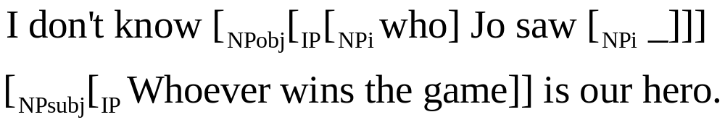
Clauses
Clauses may appear as post-modifiers for nouns, basically a kind of adjective clause, sharing their subjects with the containing sentence
One common clause type substitutes a wh-word like who or what for a direct object of a verb in the embedded clause, to create a questioned noun phrase or indirect question: (I don’t know who Jo saw ).
Show in the phrase-structure diagram

Slide 79
Sentences
There are various characteristic types of sentences.
  Declarative: I gave her a book.
  Yes-no question: Did you give her a book?
  Wh-question: What did you give her?
  Alternatives question: Did you give her a book a scarf, or a knife?
  Tag question: You gave it to her, didn’t you?
  Passive: She was given a book.
  Cleft: It must have been a book that she got.
  Exclamative: Hasn’t this been a great birthday!
  Imperative: Give me the book.

Slide 80
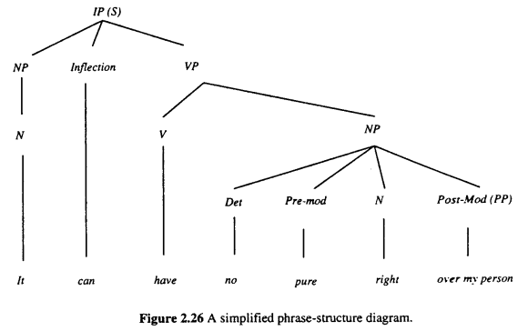
2.4.1.3 Parse Tree Representations
Sentences can be diagrammed in parse trees to indicate phrase-internal structure and linear precedence and immediate dominance among phrases

Slide 81
2.4.2 Semantic Roles
Sometimes called case relations
A typical inventory of case roles is given below:
  Agent cause or initiator of action, often intentional
  Patient/Theme undergoer of the action
  Instrument how action is accomplished
  Goal to whom action is directed
  Result result of action
  Location location of action
These can be realized under various syntactic identities, and can be assigned to both required complement and optional adjuncts
Analysis | Example
 | Kim | put | the book | on the table.
Grammatical functions | Subject (NP) | Predicate (VP) | Object (NP) | Adverbial (ADVP)
Semantic roles | Agent | Instrument | Theme | Location

Slide 82
Analysis | Example
 | The book | was put | on the table.
Grammatical functions | Subject (NP) | Predicate (VP) | Adverbial (ADVP)
Semantic roles | Agent | Instrument | Location
Analysis | Example
 | Kim | Put | The shot.
Grammatical functions | Subject (NP) | Predicate (VP) | object (NP)
Semantic roles | Agent | Instrument | Theme
The lexical meaning of a verb can be further decomposed into primitive semantic relations such as CAUSE, CHANGE, and BE.

Slide 83
2.4.3 Lexical Semantics
The specification of particular meaning templates for individual senses of particular words
Single word could participate in multiple relations of different kinds.
The level of meaning before words are composed into phrases and sentences

Slide 84
EX.
  knife appears in the examples for similars: invited attribute as: knife-sharp, and also under Case Relations: action-instrument
This suggests that an nodes and connecting edges between them representing semantic relations

Slide 85
The biggest practical problem of lexical semantics is the context-dependent resolution of senses of words – so-called polysemy
Designers of practical speech understanding systems generally avoid the problem by limiting the domain of discourse
Ex. bank
  Bank of the stream as opposed to money in the bank. While lexicographers try to identify distinct senses when they write dictionary entries , it has been generally difficult to rigorously quantify exactly what counts as a discrete sense of a word.

Slide 86
2.4.4 Logical Form
There is a metalanguage in which to concretely and succinctly express all linguistically possible meanings of an utterance
Favored metalanguage is called predicate logic, used to represent the logical form, or context-independent meaning.
The semantic component of many SLU architectures builds on a substrate of two-valued, first-order logic.
Ex.
Romeo isn’t happy, but Tybalt is.
=

